Slide 1
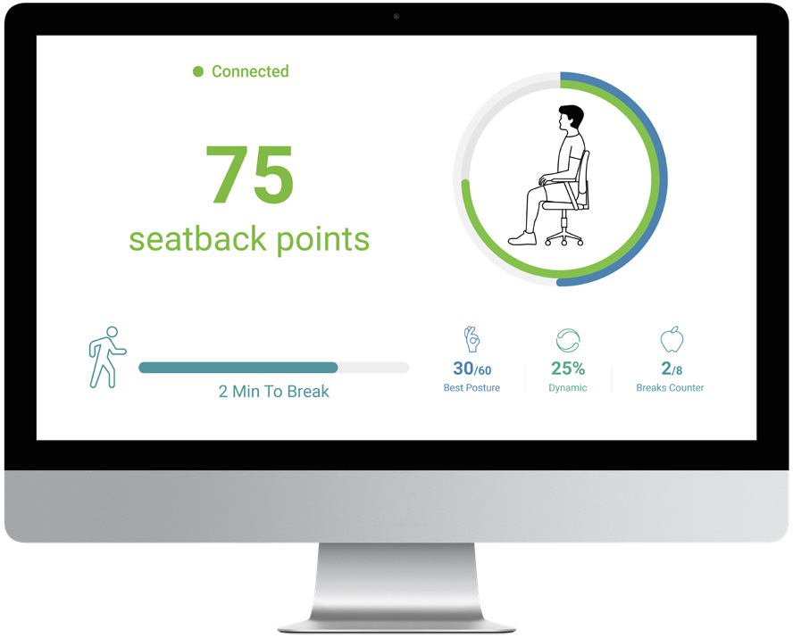
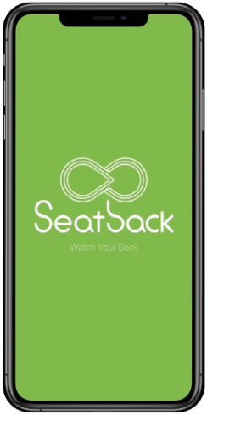
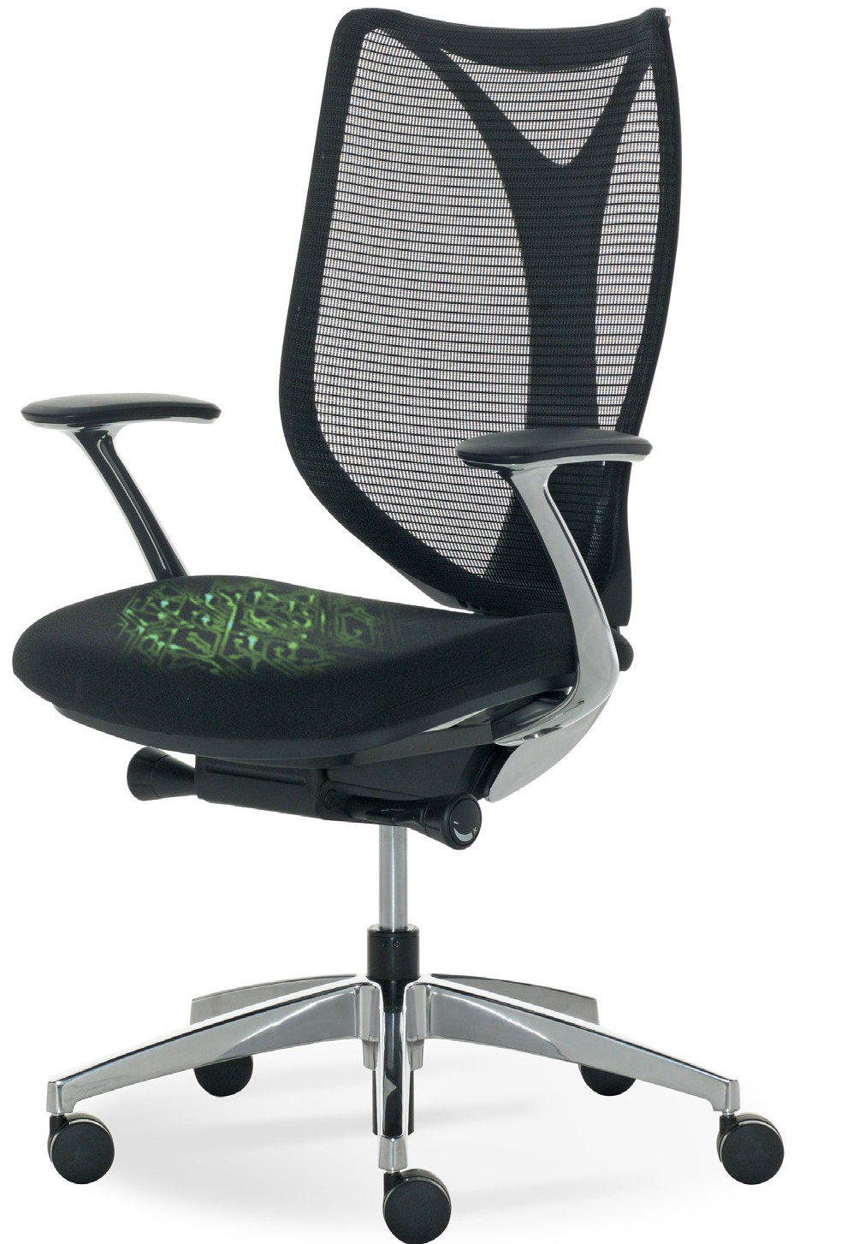
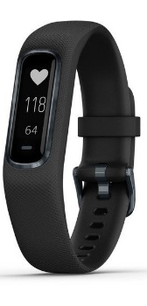
Seatback Website - Corporate wellness system

Slide 2
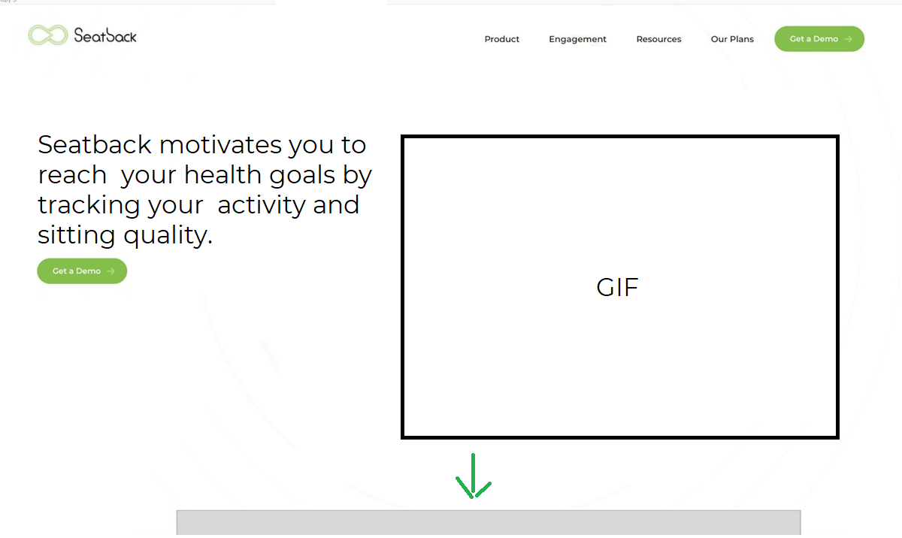
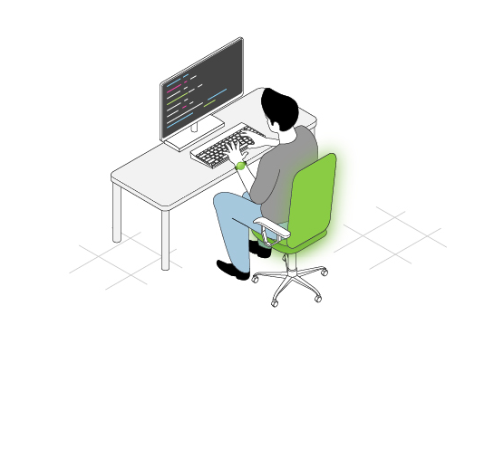
Main website page
Our custom animation – we can show you how it looks fully animated separately.
Seatback Website - Corporate wellness system

Slide 3
Main website page
Our custom animation – we can show you how it looks fully animated separately.
Seatback Website - Corporate wellness system
User scrolls down

Slide 4
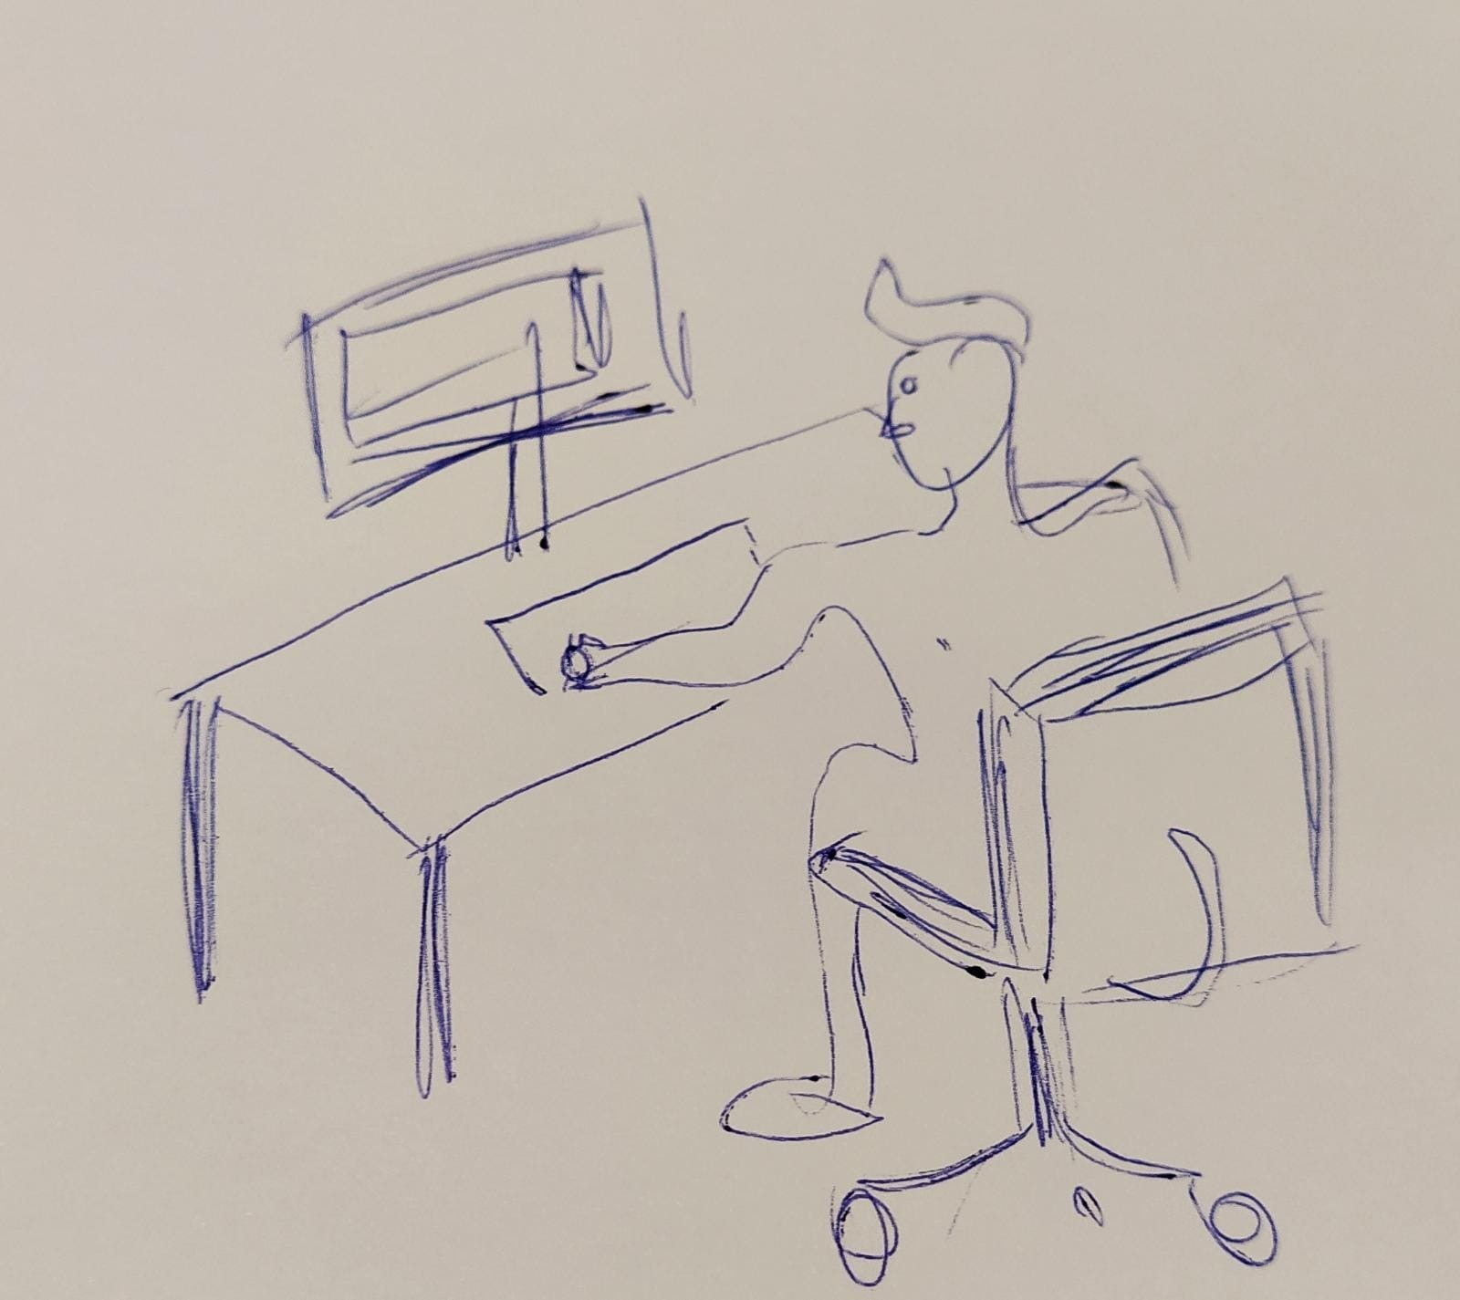
And simply being directed to the ‘Seatback+’ film
Elements from the ‘GIF’ of the guy from above will go down in a beautiful animation and will ‘sit’ on the film – to encourage the user to see the film. ***Like in Monday.com first website scroll
Seatback Website - Corporate wellness system

Slide 5
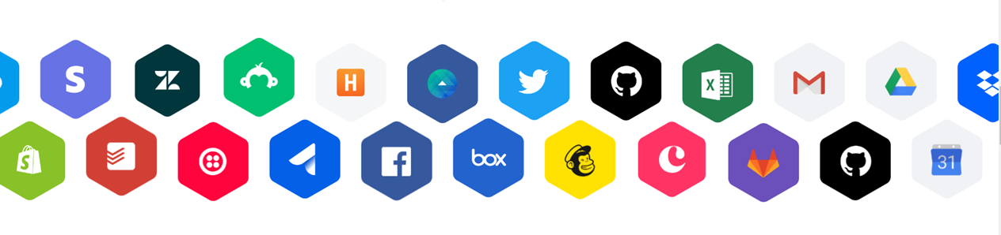
Our customers and partners (moving animation of logos) like in Monday.com

Slide 6
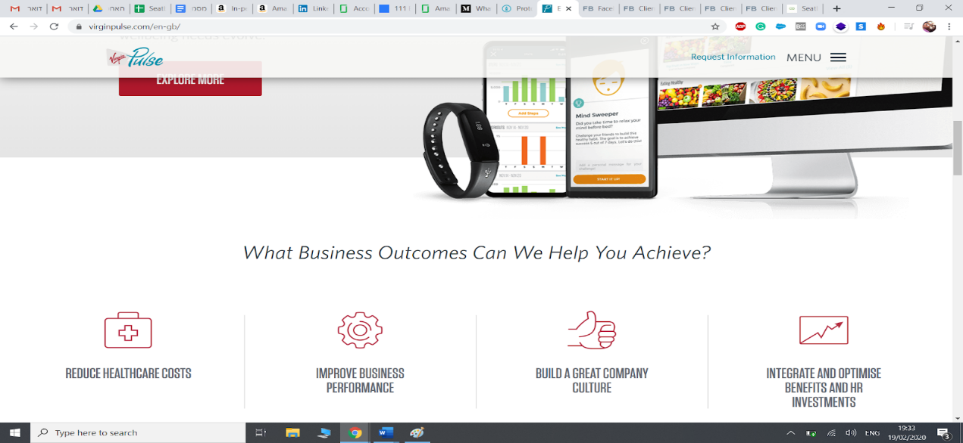
Scrolling down, the user will see our products overview and how they integrate with the Seatback + platform and together are the perfect holistic solution for organizations to make the transformation Corporate Health Leaders with these main key selling points:

Slide 7
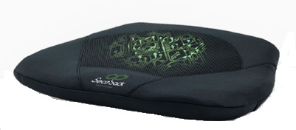
CONTENT CONTENT
CONTENT
CONTENT
CONTENT
CONTENT
CONTENT

Slide 8
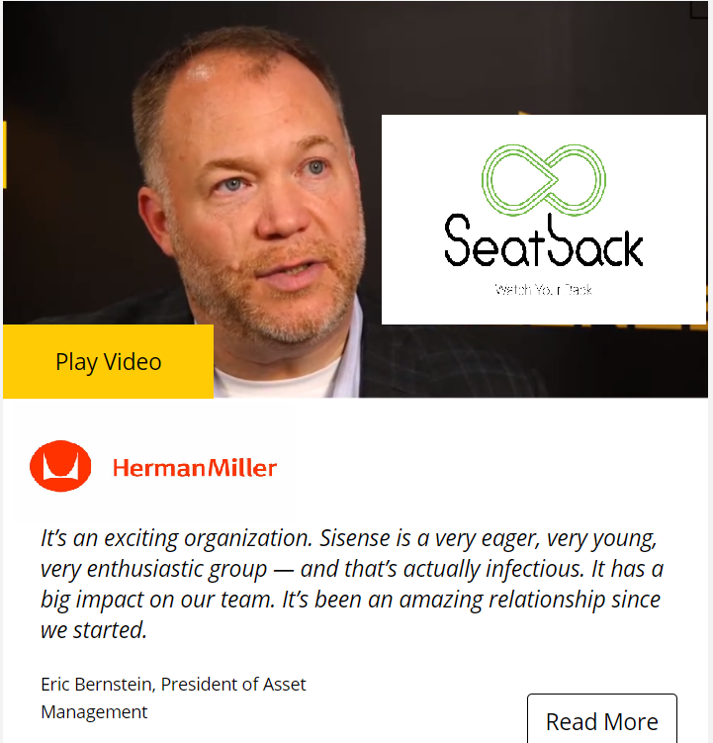
CONTENT CONTENT
CONTENT
CONTENT
CONTENT
CONTENT
CONTENT

Slide 9

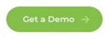
Seatback+ for Enterprise
A fully scalable, flexible and secure Corporate Wellness solution Empowering your employees to perform better and reach their Health Goals
Learn more

Slide 10
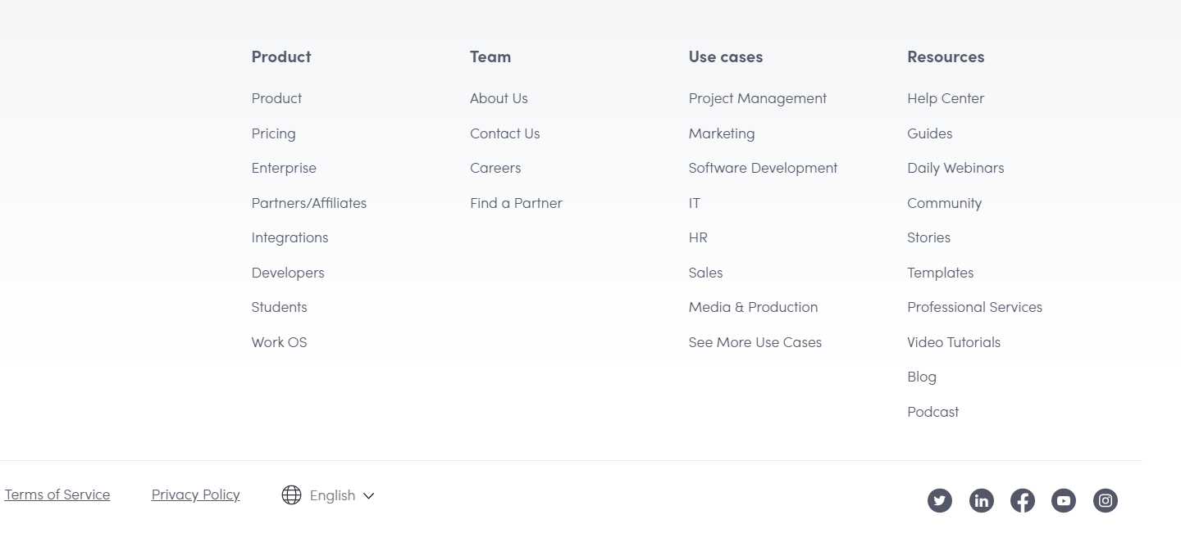
Seatback+ for Enterprise
A fully scalable, flexible and secure Corporate Wellness solution Empowering your employees to perform better and reach their Health Goals
Learn more
End of Website

Slide 11
Going back to the first screen!

Slide 12
Main website page
Seatback Website - Corporate wellness system

Slide 13
Seatback+
Animation of Seatback+ Platform screens User Experience inside this monitor
Seatback+ system explanation
-Bullet -Bullet -Bullet

Slide 14
Shows and explains everything regarding Seatback’s ergonomics products, the chairs and the portable device and shows the exact technology and how we involve it with data to help the user get insights on his Core Ergonomic Metrics.
Up and down levitating animation
Seatback Ergo explanation
-Bullet -Bullet -Bullet

Slide 15
Shows and explains everything in regards to the data we extract from the different kinds of Smart Watches and the integration we do provide for them with our system, and how everything works together.
Up and down levitating animation
Seatback Active explanation
-Bullet -Bullet -Bullet

Slide 16
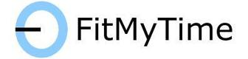
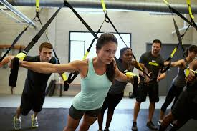

Will show a preview and the variety of the different Health Classes we provide (through fitmytime) and there would be a button and set of features that the user would be able to schedule a lesson through our platform and through the website.

Slide 17
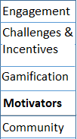
Will show a preview and the variety of the different Health Classes we provide (through fitmytime) and there would be a button and set of features that the user would be able to schedule a lesson through our platform and through the website.

Slide 18
Challenges and Incentives that will explain about our reward system in the fashion of earning “S+ Coins” by performing different sports activities that would be measured and monitored by the Seatback devices and will allow the users to buy health related products and services with 1000’s of providers.
Bullet
Bullet Bullet

Slide 19
Challenges and Incentives that will explain about our reward system in the fashion of earning “Health Coins” by performing different sports activities that would be measured and monitored by the Seatback devices and will allow the users to buy health related products and services with 1000’s of providers.
Bullet
Bullet Bullet

Slide 20
Gamification that will explain about the gamified approach in which we encourage and motivate the user to use our system perform all of the relevant activities we recommend.
Some examples could be: Motivators (Scrolling down from this 1st page)
Wellness minutes measure the time spent performing each activity. Unlike steps, reps, or other measurements that often act as disincentives to participation, minutes encourage employees to keep going.
Levels are displayed with an employee’s profile image in the Grokker Community. As employees continue to engage with Grokker and accumulate wellness minutes, they unlock new levels.
Streaks track activity and provide feedback and encouragement to your employees, reinforcing continued engagement.
Personal records celebrate the positive and emphasize building new habits instead of breaking bad ones. Email and app notifications focus on an employee’s accomplishments to keep goals top of mind amidst life’s daily distractions.
Badges notify employees of their accomplishments, let them know they’re getting closer to their goals, and remind them of their achievements throughout the day.
Classes / Lessons After pressing this tab the user would be brought to a new page where an explanation regarding our ‘Fit-my-time’ feature will be available, with a lot of photos, the variety of our classes and a ‘Schedule a Training Session’ button that would help the user schedule a health lesson through our platform.
All of this information is being shown in bullets and with minimalistic designs.
MORE ICONS – LESS TEXT

Slide 21
Gamification that will explain about the gamified approach in which we encourage and motivate the user to use our system perform all of the relevant activities we recommend.
Some examples could be: Motivators (Scrolling down from this 1st page)
Wellness minutes measure the time spent performing each activity. Unlike steps, reps, or other measurements that often act as disincentives to participation, minutes encourage employees to keep going.
Levels are displayed with an employee’s profile image in the Grokker Community. As employees continue to engage with Grokker and accumulate wellness minutes, they unlock new levels.
Streaks track activity and provide feedback and encouragement to your employees, reinforcing continued engagement.
Personal records celebrate the positive and emphasize building new habits instead of breaking bad ones. Email and app notifications focus on an employee’s accomplishments to keep goals top of mind amidst life’s daily distractions.
Badges notify employees of their accomplishments, let them know they’re getting closer to their goals, and remind them of their achievements throughout the day.
Classes / Lessons After pressing this tab the user would be brought to a new page where an explanation regarding our ‘Fit-my-time’ feature will be available, with a lot of photos, the variety of our classes and a ‘Schedule a Training Session’ button that would help the user schedule a health lesson through our platform.
All of this information is being shown in bullets and with minimalistic designs.

Slide 22
Will get the user scrolling down to the Motivators section Motivators (Scrolling down from this 1st page)
Wellness minutes measure the time spent performing each activity. Unlike steps, reps, or other measurements that often act as disincentives to participation, minutes encourage employees to keep going.
Levels are displayed with an employee’s profile image in the Grokker Community. As employees continue to engage with Grokker and accumulate wellness minutes, they unlock new levels.
Streaks track activity and provide feedback and encouragement to your employees, reinforcing continued engagement.
Personal records celebrate the positive and emphasize building new habits instead of breaking bad ones. Email and app notifications focus on an employee’s accomplishments to keep goals top of mind amidst life’s daily distractions.
Badges notify employees of their accomplishments, let them know they’re getting closer to their goals, and remind them of their achievements throughout the day.
Classes / Lessons After pressing this tab the user would be brought to a new page where an explanation regarding our ‘Fit-my-time’ feature will be available, with a lot of photos, the variety of our classes and a ‘Schedule a Training Session’ button that would help the user schedule a health lesson through our platform.
All of this information is being shown in bullets and with minimalistic designs.

Slide 23
Will get the user scrolling down to the Motivators section Motivators (Scrolling down from this 1st page)
Wellness minutes measure the time spent performing each activity. Unlike steps, reps, or other measurements that often act as disincentives to participation, minutes encourage employees to keep going.
Levels are displayed with an employee’s profile image in the Grokker Community. As employees continue to engage with Grokker and accumulate wellness minutes, they unlock new levels.
Streaks track activity and provide feedback and encouragement to your employees, reinforcing continued engagement.
Personal records celebrate the positive and emphasize building new habits instead of breaking bad ones. Email and app notifications focus on an employee’s accomplishments to keep goals top of mind amidst life’s daily distractions.
Badges notify employees of their accomplishments, let them know they’re getting closer to their goals, and remind them of their achievements throughout the day.
Classes / Lessons After pressing this tab the user would be brought to a new page where an explanation regarding our ‘Fit-my-time’ feature will be available, with a lot of photos, the variety of our classes and a ‘Schedule a Training Session’ button that would help the user schedule a health lesson through our platform.
All of this information is being shown in bullets and with minimalistic designs.

Slide 24
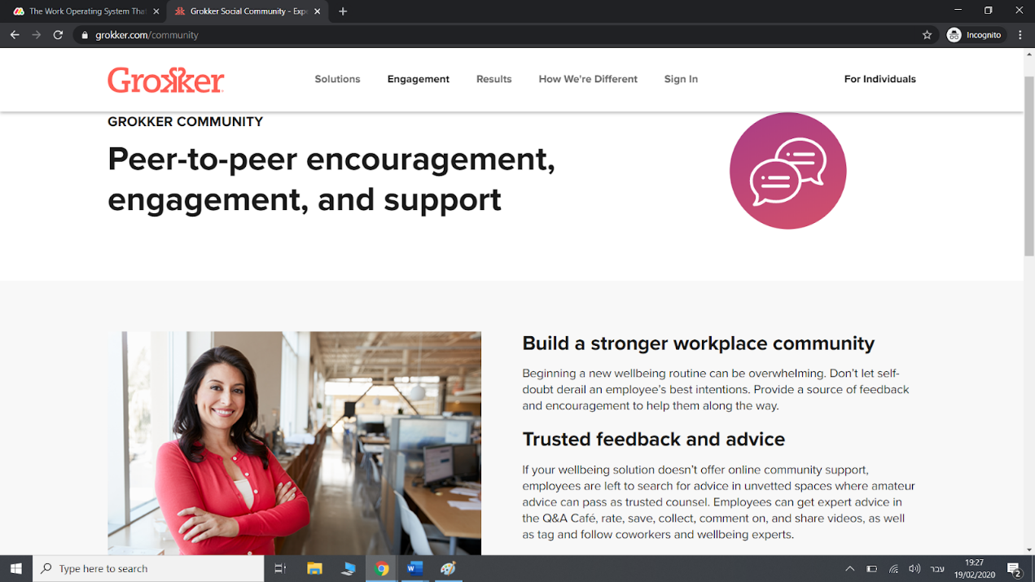
Community will show our user how Seatback would help in building the healthy company culture that every company wants, and the business and mental benefits of using our platform. Inspiration:

Slide 25
Resources
About Us
Blog
Community will show our user how Seatback would help in building the healthy company culture that every company wants, and the business and mental benefits of using our platform. Inspiration:
Help Center
Press
Case Studies
Get a Demo
Will go on the same direction of the whole website

Slide 26
Seatback’s Mission
Seatback’s story will go here with some icons of success and happiness (starts, smiles, happy families, etc’).

Slide 27
Resources
About Us
Seatback’s Mission
Blog
Help Center
Press
Seatback’s story will go here with some icons of success and happiness (starts, smiles, happy families, etc’).
Case Studies
Get a Demo

Slide 28
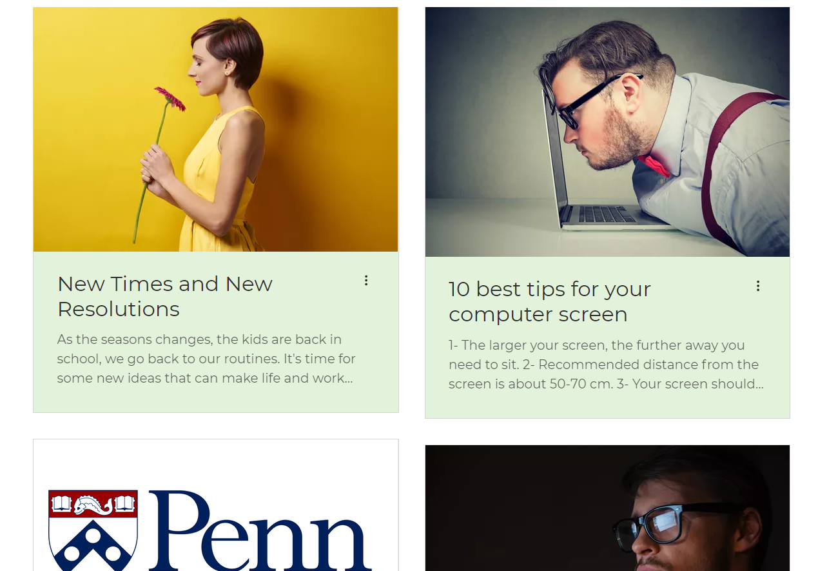
Blog
All of our articles and a search bar to browse between them

Slide 29
Resources
About Us
Blog
Blog
Help Center
Press
All of our articles and a search bar to browse between them
Case Studies
Get a Demo

Slide 30
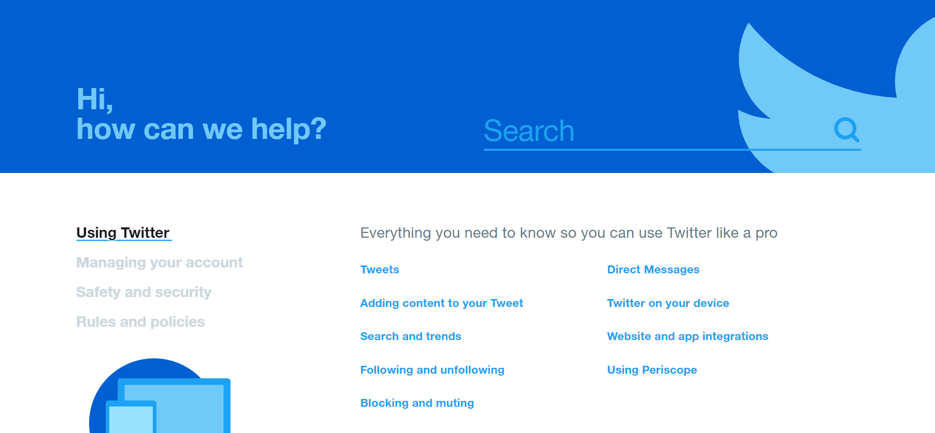
Our help center
Example:

Slide 31
The fourth and last section of the Website is our ‘Pricing’ Section that sends the user to the pricing page that will be structured per the Seatback pricing model:
Tier | Seatback + | Seatback Ergo | Seatback Live | Seatback Active
Functions |  |  |  | Recommended (Bonus)
Seatback content SaaS Platform | ˅ | ˅ | ˅ | ˅
Chair / Portable |  | ˅ | ˅ | ˅
Smart Watch |  |  | ˅ | ˅
Wellness class |  |  |  | ˅
Obviously, all of that would be designed per the Seatback design vision and guidelines.

Slide 32
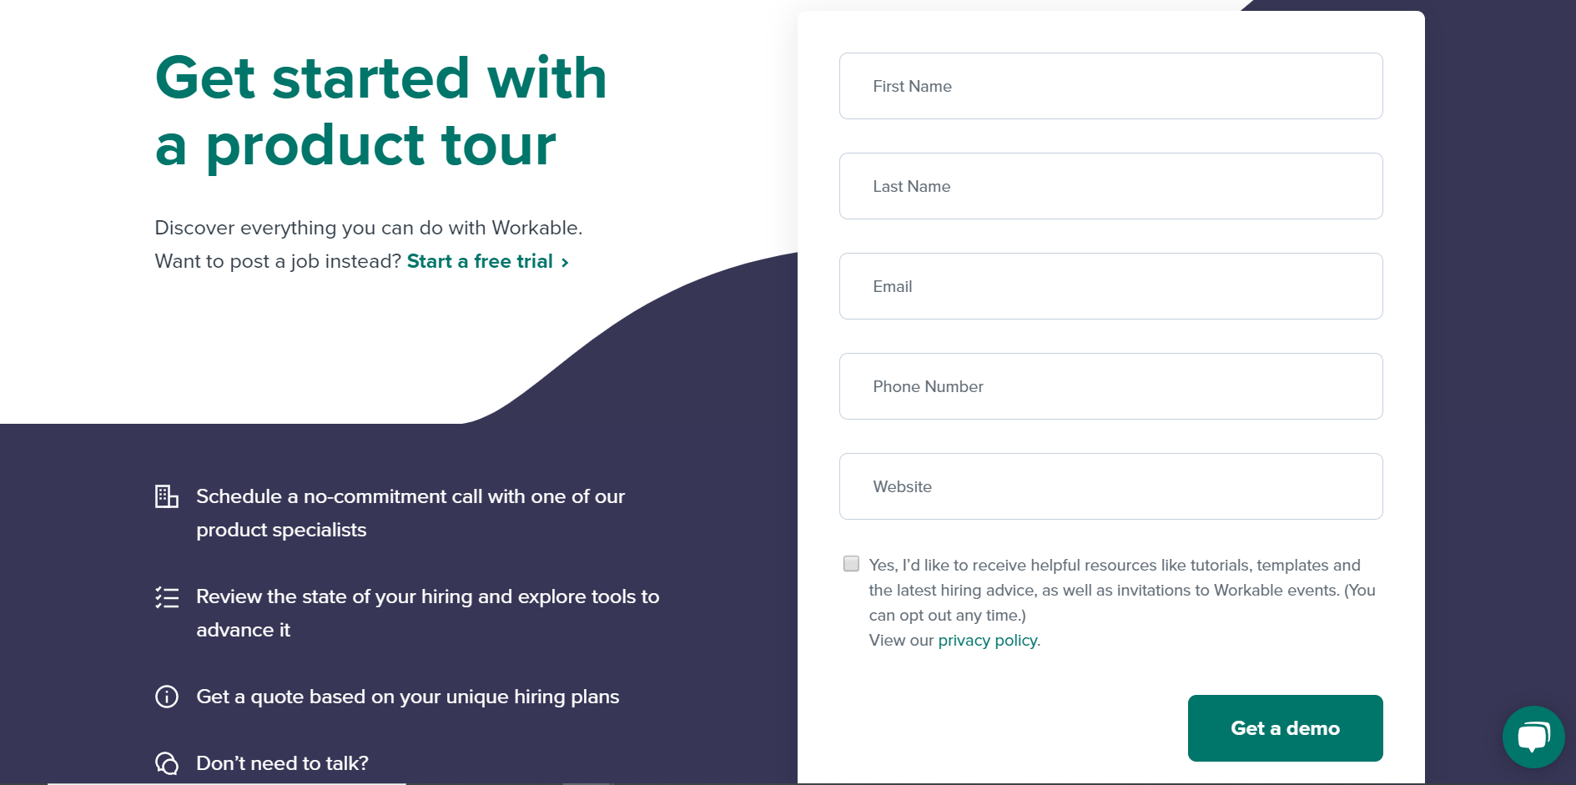
The fourth and last section of the Website is our ‘Pricing’ Section that sends the user to the pricing page that will be structured per the Seatback pricing model:
Discover everything you can do with Seatback today!
Discover everything you can do with Seatback today!
Tier | Seatback + | Seatback Ergo | Seatback Live | Seatback Active
Functions |  |  |  | Recommended (Bonus)
Seatback content SaaS Platform | ˅ | ˅ | ˅ | ˅
Chair / Portable |  | ˅ | ˅ | ˅
Smart Watch |  |  | ˅ | ˅
Wellness class |  |  |  | ˅
Experience the improvements in employees health metrics within days!
Obviously, all of that would be designed per the Seatback design vision and guidelines.

